Slide 1
NODEJS INTRO
Ivaniuk Oleh
12.2019

Slide 2
AGENDA
Node.js overview
Node.js modules
NPM
Package.json file
NodeJS installation
First Node.js application
Request and response methods

Slide 3
WHAT NODE.JS IS
Created in 2009, Open-sourced for now.
JavaScript runtime. Not a language or a framework
Runs on v8 JavaScript engine, same a Google Chrome
Written on C++ & JavaScript
Node.js runs on various platforms (Windows, Linux, Unix, Mac OS X, etc.)
Node.js uses JavaScript on the server
Node.js = Runtime Environment + JavaScript Library

Slide 4
FEATURES OF NODE.JS
Asynchronous and Event Driven − All APIs of Node.js library are asynchronous, that is, non-blocking. It essentially means a Node.js based server never waits for an API to return data. The server moves to the next API after calling it and a notification mechanism of Events of Node.js helps the server to get a response from the previous API call.
Very fast − Being built on Google Chrome's V8 JavaScript Engine, Node.js library is very fast in code execution.
Single Threaded but Highly Scalable − Node.js uses a single threaded model with event looping. Event mechanism helps the server to respond in a non-blocking way and makes the server highly scalable as opposed to traditional servers which create limited threads to handle requests. Node.js uses a single threaded program and the same program can provide service to a much larger number of requests than traditional servers like Apache HTTP Server.
No Buffering − Node.js applications never buffer any data. These applications simply output the data in chunks.

Slide 5
NODE.JS ARCHITECTURE
Node.js is ideal for I/O-intensive apps

Slide 6
ADVANTAGES
Fast and event-based
Scalable
Rich ecosystem
DISADVANTAGES
Not suited for CPU-intensive tasks
Asynchronous model is difficult to learn and understand
API is not super-stable

Slide 7
USE NODE.JS FOR:
Front-end (Webpack, front-end tools, .etc)
Back-end (API, microservices, REST/GraphQL/Sockets…)
Desktop apps (Electron: Slack, Atom, VS Code, WhatsApp)
Bots
IoT (Cylon.js/JohnnyFive)
CLI
DON’T USE NODE.JS FOR:
CPU-heavy jobs
Image processing
BigData processing / Math
Notes:
Якщо узагальнити, то node.js використовується для всього, що не вимагає інтенсивного використання CPU

Slide 8
NODE.JS MODULES
Node.js uses a modular system. That is, all built-in functionality is divided into separate packages or modules.
A module is a block of code that can be reused in other modules.
Consider modules to be the same as JavaScript libraries.
Node.js has a set of built-in modules which you can use without any further installation.
To include a module, use the require() function with the name of the module:
const url = require('url');

Slide 9
NODE.JS POPULAR MODULES
Express is a popular, fast Node.js framework for web and mobile application development.
Socket.io - framework for building realtime applications
Mongo/Mongoose – wrappers to interact with MongoDB.
Pug/Jade – template engine inspired by HAML
Keystone.JS - designed for building database-driven websites, applications and APIs
Passport is a unique authentication module for Node.js devs
Nodemon is a utility that will monitor for any changes in your source and automatically restart your server.

Slide 10
NPM
NPM is a Node.js Package Manager
NPM used to install node packages/modules
The NPM program is installed on your computer when you install Node.js (to check the NPM version use “npm -v”)
NPM creates a folder named "node_modules", where the package will be placed.
npm install <module_name> // how to install any Node.js module
npm install express // install a package locally
npm install -g express // install a package globally
Notes:
Крім вбудованих і кастомних модулів Node.js існує величезний пласт різних бібліотек і фреймворків, різноманітних утиліт, які створюються сторонніми виробниками, і які також можна використовувати в проекті, Щоб зручніше було працювати з усіма сторонніми рішеннями, вони поширюються у вигляді пакетів. Пакет по суті являє набір функціональностей.

Slide 11
PACKAGE.JSON FILE
all dependencies are listed in a “package.json” file
package.json is present in the root directory of any Node application/module
npm init // create a package.json file
{
"name": "node-js-sample",
"version": "0.2.0",
"description": "A sample Node.js app using Express 4",
"main": "index.js",
"author": "Mark Pundsack"
"dependencies": {
"express": "^ 4.13.3“,
"mongojs": "^ 2.4.0"
}
}

Slide 12
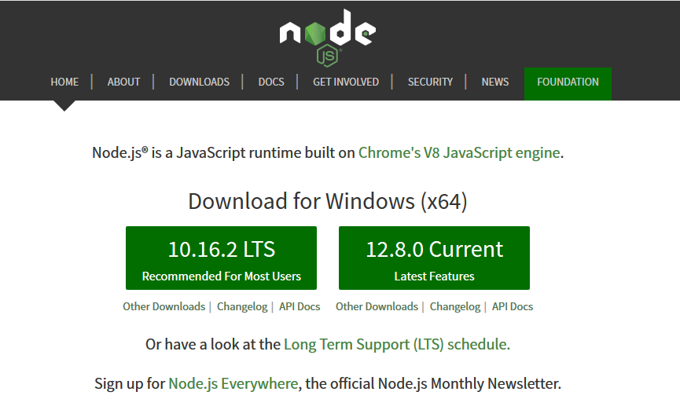
NODEJS INSTALLATION
1. Download installation package from https://nodejs.org/ . For Windows, this is a file with the msi extension.
2. If you have a different operating system, select Other Downloads and download the required installation package.

Slide 13

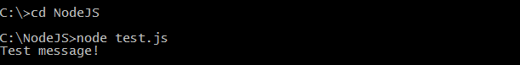
VERIFY INSTALLATION: CHECK VERSION & EXECUTING A FILE .
1. After a successful installation, you can enter the node -v command on the command line / terminal and the current version of node.js will be displayed:
2. Create a js file named test.js on your PC in directory, for example, NodeJS having the following code:
At the command prompt, use the cd command to navigate to the NodeJS directory, and then run the command node test.js, which will execute the code from the test.js file:
console.log("Test message!");

Slide 14
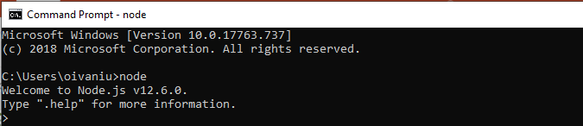
NODE.JS REPL Terminal
REPL stands for Read Eval Print Loop and it represents a computer environment like a Windows console or Unix/Linux shell where a command is entered and the system responds with an output in an interactive mode.
Node.js comes bundled with a REPL environment. It performs the following tasks:
Read − Reads user's input, parses the input into JavaScript data-structure, and stores in memory.
Eval − Takes and evaluates the data structure.
Print − Prints the result.
Loop − Loops the above command until the user presses ctrl-c twice.
REPL can be started by simply running node on shell/console without any arguments:

Slide 15
WORK WITH FILE SYSTEM
To work with the file system, we need to use the fs module.
Read files:
1) fs.readFile(path [, options], callback)
2) fs.readFileSync(path [, options])
path - filename
options – encoding type
callback - function which pass two arguments (err, data), where data is the contents of the file.
Write files:
fs.writeFile(file, data [, options], callback)

Slide 16
FIRST NODE.JS APPLICATION
A Node.js application consists of the following three important components:
- Import required modules − We use the require directive to load Node.js modules.
- Create server − A server which will listen to client's requests similar to Apache HTTP Server.
- Read request and return response − The server created in an earlier step will read the HTTP request made by the client which can be a browser or a console and return the response.

Slide 17
1) IMPORT REQUIRED MODULE
In the browser, when we want to add a JS file to the page, we use the <script> tag, and in NodeJS require. In essence, a module is a file that is connected using require.
So, we use the require directive to load the http module and store the returned HTTP instance into an http variable as follows:
const http = require("http");

Slide 18
2) CREATE SERVER
We use the created http instance and call http.createServer() method to create a server instance and then we bind it at port 8000 using the listen() method associated with the server instance. Pass it a function with parameters request and response.
http.createServer( function(request, response) {
// Send the HTTP header with HTTP Status: 200=OK, Content Type: text/plain
response.writeHead(200, {'Content-Type': 'text/html'});
// Send the response body as "Testing NodeJS server"
response.end('Testing NodeJS server\n');
}).listen(8000);
// Console will print the message
console.log('Server running at http://127.0.0.1:8000/');

Slide 19

3) TESTING REQUEST & RESPONSE
Import the required module and create a server in the server.js file and start our HTTP server as shown below:
const http = require("http");
http.createServer(function (request, response) {
response.writeHead(200, {'Content-Type': 'text/plain'});
response.end('Testing NodeJS server\n');
}).listen(8000);
console.log('Server running at http://127.0.0.1:8000/');
Now execute the server.js to start the server and verify the output:

Slide 20
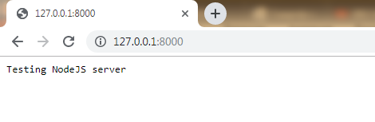
REQUEST TO THE NODE.JS SERVER
Open http://127.0.0.1:8000/ or http://localhost:8000 in any browser and observe the following result.

Slide 21
REQUEST METHODS
The request parameter provides information about the request and represents the http.IncomingMessage object. We note some basic properties of this object:
headers: returns request headers
method: request type (GET, POST, DELETE, PUT)
url: represents the requested address

Slide 22
RESPONSE METHODS
The response parameter controls the response and represents the http.ServerResponse object. Among its functionality, the following methods can be distinguished:
statusCode: sets the response status code
statusMessage: sets the message sent with the status code
setHeader(name, value): adds one header to the response
write: writes some content to the response stream
writeHead: adds a status code and a set of headers to the response
end: signals to the server that the headers and body of the response are set, as a result, the response is sent to the client. This method should be called in each request.

Slide 23
USEFUL LINKS
https://nodejs.org
https://www.tutorialspoint.com/nodejs/index.htm
https://www.w3schools.com/nodejs/
https://medium.com/webbdev/js-db3d35ffed7e

Slide 24
THANKS

